Slide 1


Design & Implementation of an Automated Data Visualization System for Exploratory Data Analysis
DSA 0613 – Data Handling & Visualization for Data Analytics
Presented by:
VISWANATH SAI SANDEEP (1923242029)
G VENKATA GOUTHAM REDDY (192324265)
T LAKSHMI PRASAD NAIDU (192324187)
Supervisor:
Dr. Kumaragurubaran
Dr. Senthil Vadivu
Dept of CSE
Saveetha School of Engineering

Slide 2
Introduction
Overview:
Exploratory Data Analysis (EDA) helps in understanding data through graphs and charts. However, beginners often find it difficult to choose the right type of visualization. This project focuses on creating a simple automated system that generates visualizations to help users understand data easily.
Problem Statement:
Most data visualization tools are complex and require technical knowledge. Users must manually select graph types, which can be confusing for students and teachers. There is a need for a simple application that automatically visualizes data.
Purpose of the Project:
To automatically generate graphs from uploaded datasets
To help users understand data visually
To provide an easy and beginner-friendly data visualization tool

Slide 3
Objectives
Overview Goals:
To design an automated system for exploratory data analysis
To visualize datasets using appropriate graphs automatically
To reduce manual effort in selecting suitable data visualizations
To make data analysis easy for beginners, students, and teachers
Expected Outcomes:
Automatic generation of meaningful graphs from uploaded datasets
Clear visual understanding of data patterns and trends
Ability to switch between different plot types easily
Improved learning and interpretation of data through visualization

Slide 4
Literature Review / Background
Summary of Existing Research and Research Gap
Aspect | Existing Research | Research Gap
Data Visualization Tools | Tools like Excel, Tableau etc. provide various charts & graphs. | These tools are complex & not beginner friendly.
Exploratory Data Analysis (EDA) | EDA Techniques help in understanding data patterns & distributions. | Manual selection of graphs requires technical knowledge.
Automation in Visualization | Some tools offer limited automatic visualization features. | Lack of fully automated & simple visualization systems.
User Interface | Many platforms use dashboards with multiple options. | No minimal & student-friendly interface for easy understanding.
Educational Use | Visualization is used in teaching data analysis concept. | Tools are not designed specifically for students & teachers

Slide 5
Methodology
Tools & Frameworks:
Programming Language: Python
Frontend / Visualization: Tkinter ( Python GUI Library)
Libraries: NumPy, Pandas, Matplotlib, Seaborn
Development Methodology:
Collect and load the dataset uploaded by the user.
Preprocess the data and handle missing values.
Automatically detect numeric, categorical, and date columns.
Select appropriate visualization types based on data characteristics.
Generate graphs using Matplotlib and Seaborn.
Display graphs in a user-friendly popup window.
Allow users to switch between different plot types interactively.

Slide 6
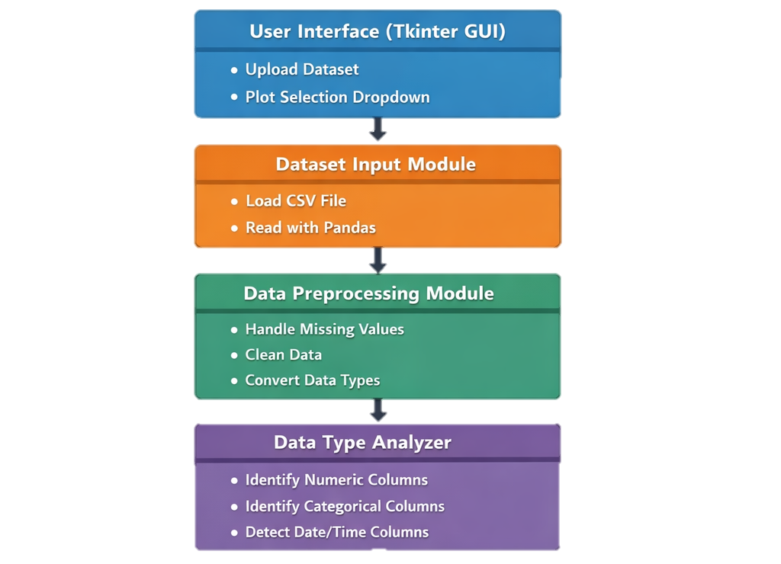
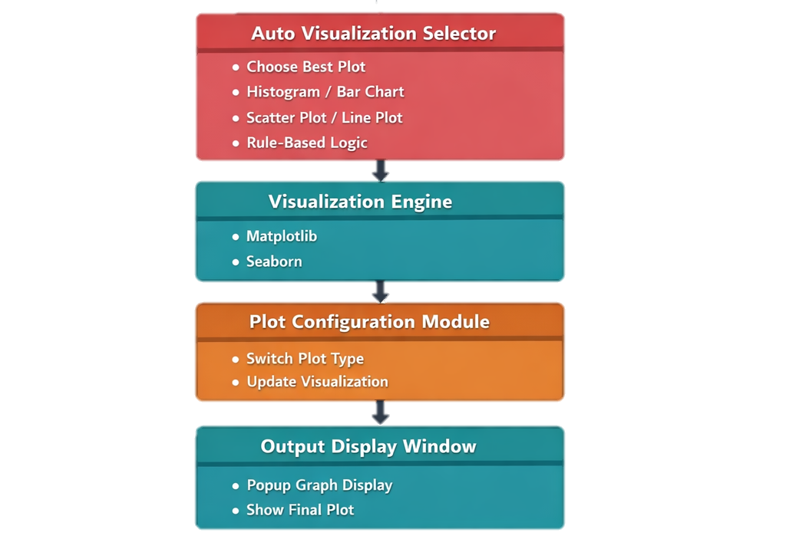
Block Diagram

Slide 7
List of Modules
Module 1: User Interface & Dataset Handling
Module 2: Data Analysis & Automated Visualization
Module 3: Interactive Plot Display & Configuration

Slide 8
Module 1: User Interface & Dataset Handling
Purpose:
To provide a simple and user-friendly interface that allows users to upload datasets and interact with the visualization system.
Key Implementation Details:
Design a Tkinter-based graphical user interface
Provide file upload functionality for CSV datasets
Validate and load the dataset using Pandas
Techniques Used:
Tkinter GUI components
File handling and input validation
Pandas for data loading

Slide 9
Module 2: Data Analysis & Automated Visualization
Purpose:
To analyze the uploaded dataset and automatically select suitable visualizations for exploratory data analysis.
Key Implementation Details:
Identify numeric, categorical, and date/time columns
Apply rule-based logic to select appropriate plot types
Generate default visualizations based on data characteristics
Techniques Used:
Data type detection using Pandas
Rule-based decision logic
Matplotlib and Seaborn for plot generation

Slide 10
Module 3: Interactive Plot Display & Configuration
Purpose:
To display visualizations clearly and allow users to switch between different plot types for better data understanding.
Key Implementation Details:
Display graphs in a popup window
Provide dropdown menu for selecting different plot types
Update plots dynamically based on user selection
Techniques Used:
Tkinter popup windows
Matplotlib canvas integration
Event-driven plot updates

Slide 11
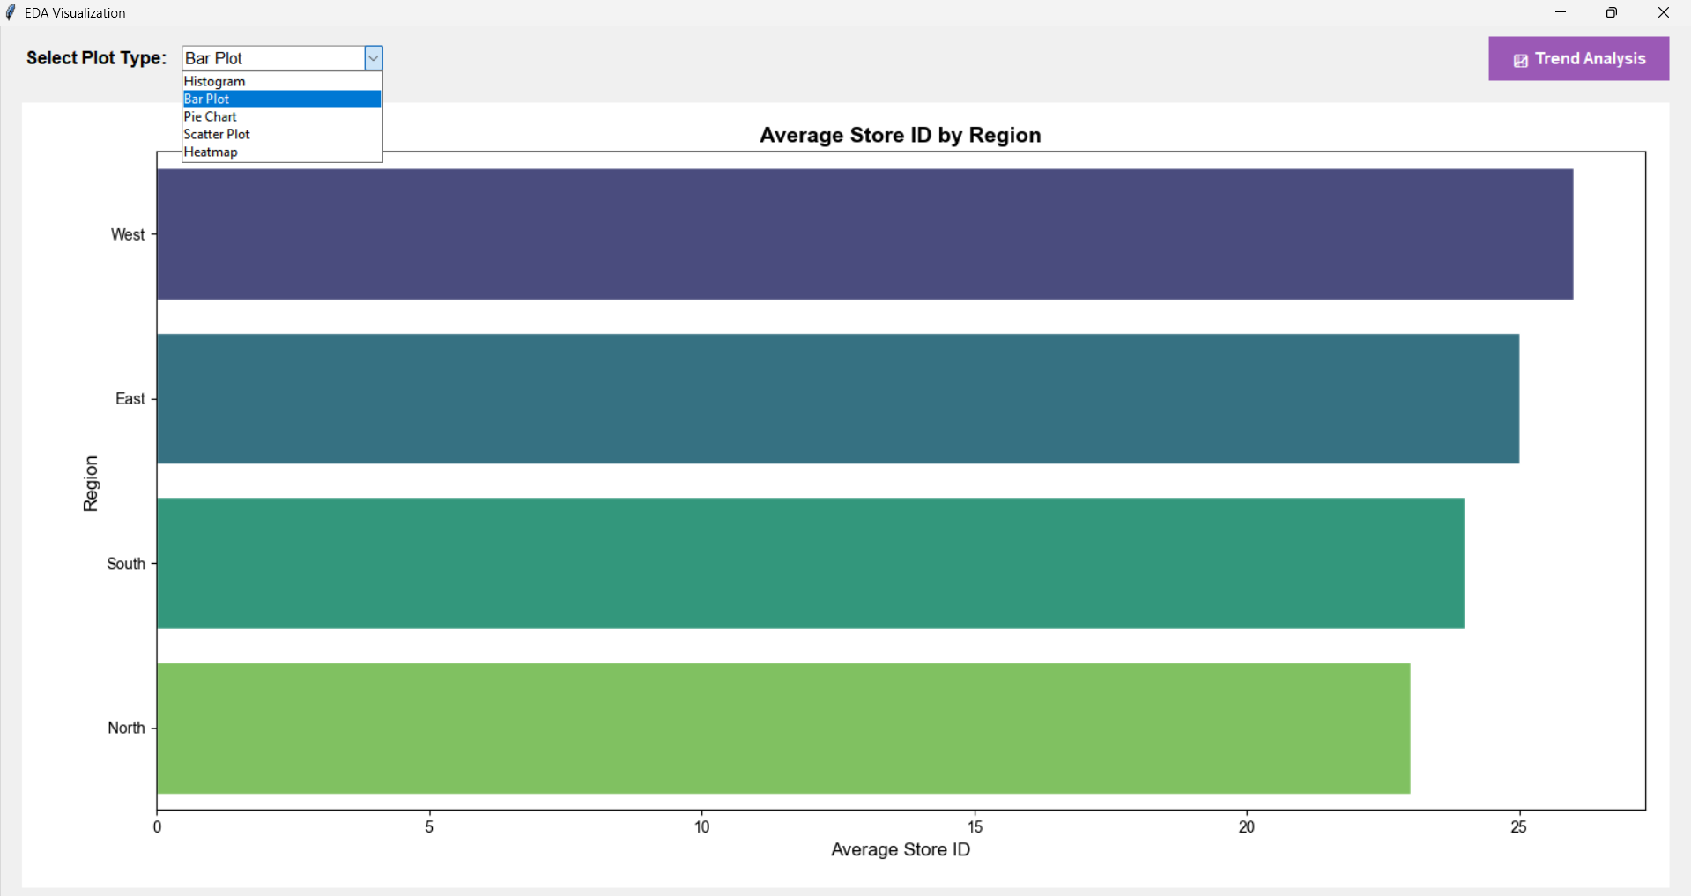
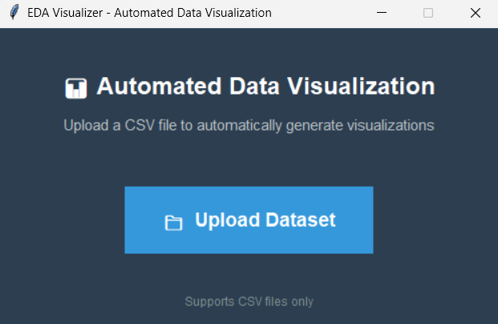
Output

Slide 12
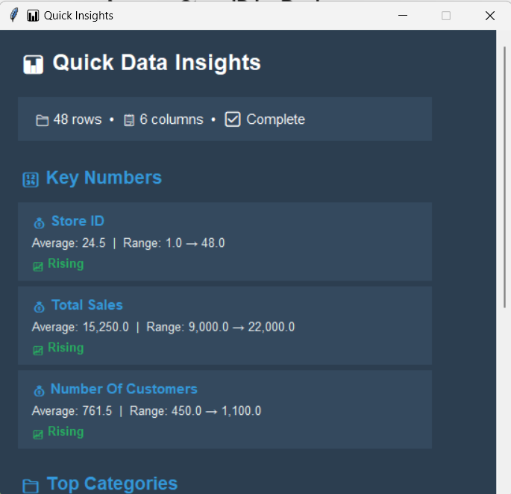
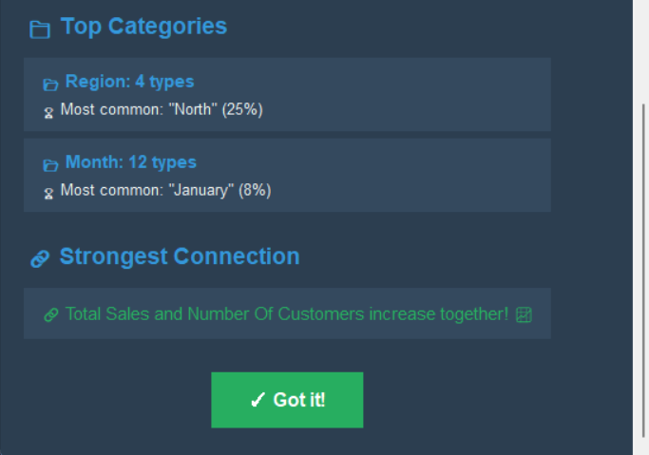
Trend Analysis

Slide 13
Results & Discussion
Outcomes of the project:
Improved Understanding of Data:
  Users can easily understand the data patterns, trends & distributions through automatically generated visualizations.
Beginner Friendly Visualization System:
  The simple interface allows users to perform EDA without prior technical knowledge.
Automated Graph Selection:
  The system automatically selects best plots based on the data type, reducing manual effort & confusion.
Interactive Visualization Experience:
Users can switch between different plot types dynamically, helping them analyze the data from multiple perspectives.
Effective Learning Tool:
The application supports learning by visually demonstrating how different graphs represents the same data.

Slide 14
Challenges & Limitations
Challenges
Automatically selecting the most appropriate visualization for different data types is complex.
Handling noisy, incomplete, or unstructured datasets affects visualization accuracy.
Ensuring fast processing for large datasets can be challenging on limited hardware.
Designing a user-friendly interface that works for non-technical users requires careful planning.
Limitations
Limited to structured datasets such as CSV files.
Rule-based visualization selection may not always produce optimal results.
Performance may degrade with very large datasets.
Limited customization options.

Slide 15
Future Scope
Advanced AI Based Visualisation Selection:
Integrate Machine Learning models to intelligently recommend more accurate & insightful visualizations based on data patterns.
Support for Multiple Data Formats:
Extend support to Excel, JSON & database connections for broader usability.
Interactive Visualizations:
Introduce interactive charts with zooming, filtering & tooltips for deeper exploration.
Integration with Learning Platforms:
Enhance the system with guided insights & explanations to help students understand data trends easily.

Slide 16
Conclusion
Summary:
Developed a user-friendly Automated Data Visualization system for EDA.
Enabled users to upload datasets & automatically generate suitable visualizations.
Used Python libraries like Pandas, NumPy, matplotlib & Seaborn for data processing & visualization.
Focused on simplicity & usability for users.
Key Takeaways:
Automated visualization helps users quickly understand data patterns and trends.
Reduces the need for manual chart selection and technical expertise.
Improves efficiency in exploratory data analysis.
The system has strong potential for future enhancements using AI and interactivity.

Slide 17
References
Jun-Peng Zhu et al., Towards Automated Cross-domain Exploratory Data Analysis through Large Language Models — describes an end-to-end automated EDA system that integrates SQL, LLMs, and visualization generation, addressing large real-world data exploration challenges.
Tova Milo & Amit Somech, Automating Exploratory Data Analysis via Machine Learning, SIGMOD ’20 — overview of techniques for automating EDA, including recommender systems and machine learning for generating visual patterns.
Dylan Wootton, Amy Rae Fox, Evan Peck, Arvind Satyanarayan, Charting EDA: Characterizing Interactive Visualization Use in Computational Notebooks, arXiv (2024) — formalizes how dynamic visualizations impact exploratory analysis workflows, relevant for tool design.
Sayan Putatunda et al., SmartEDA: An R Package for Automated Exploratory Data Analysis, arXiv (2019) — introduces an automated EDA package that generates summaries & visual insights, showing applied automation techniques.
Cagatay Demiralp et al., Foresight: Rapid Data Exploration Through Guideposts, arXiv (2017) — visualization recommender system for EDA that suggests key visual representations to users automatically.

Slide 18
Thank You !

